Slide 1

Introduction into fMRI analysis. PsyMsc4 (Goethe 2022).
Session 1
Javier Ortiz-Tudela and Francesco Pupillo

Slide 2
Who is this seminar for?
This is a hands-on workshop on functional Magnetic Resonance Imaging (fMRI) analysis for the PsyMSc4 at the Goethe University.
Very few assumptions are made about previous knowledge on the topic, so this workshop can be a very good entry point for complete beginners from any discipline. Also, the first introductory session could also be suited for non-scientists willing to get a broad idea into what MRI is.

Slide 3
What is this seminar for?
The workshops will cover which are the necessary and common steps when conducting fMRI research and how to run them with MATLAB's SPM.
The core Philosophy of the workshop is that one of the main skills that a cognitive neuroscientist should have is the ability to judge what can and what cannot be done with fMRI experiments from a conceptual level. In order to acquire such a skill, one needs to understand fMRI research , i.e., to know the basics of the technique itself and the logic behind the most common analysis.

Slide 4
How is this seminar structured?
The workshop is structured in six sessions of about 4 hours each. Each session will be dedicated to a specific processing or analysis step.
Sessions 1 - 5 will start with theory and logic behind that day's step and will continue with a hands-on exercise. Students will select a particular dataset to use for the hands-on exercises.
Session 6 will be dedicated to students' presentations. Each student will prepare a short presentation (~15 minutes / ~15 slides) describing the motivation of the study, the analysis carried out, the results obtained and their interpretation.
At the end of the workshop, each student will submit an individual brief report (2 pages max) on the results obtained with their corresponding dataset and their interpretation.
Working in groups is allowed and even encouraged. However, the individual presentations and the reports need to be unique.

Slide 5

Part I. Basics of MRI

Slide 6
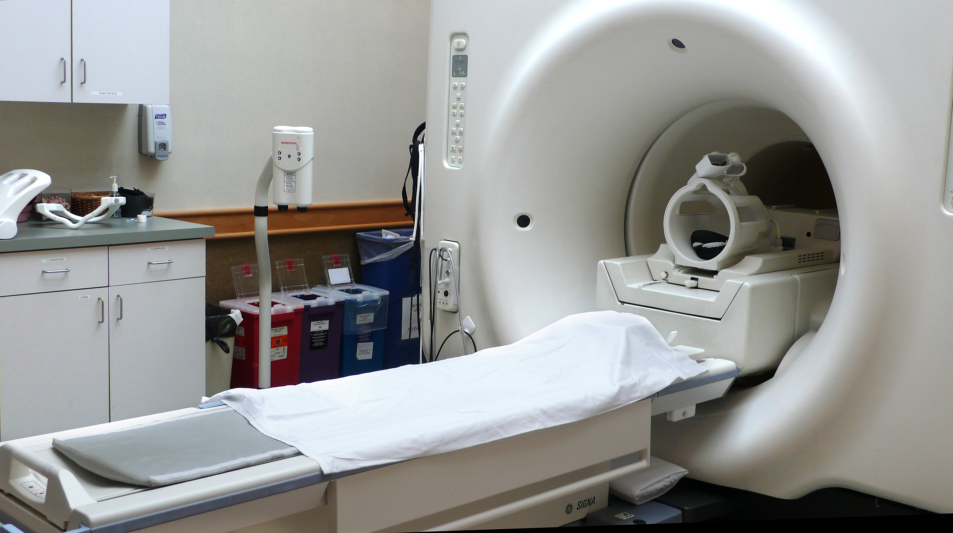
Here are the basics of MR imaging

Slide 7
Here are the basics of MR imaging
Scanner
Coil
Bed

Slide 8
Here are the basics of MR imaging
Scanner =
big magnet + radio frequency transmitter
big and very strong!
CAUTION!!
loud and annoying!
CAUTION!!

Slide 9
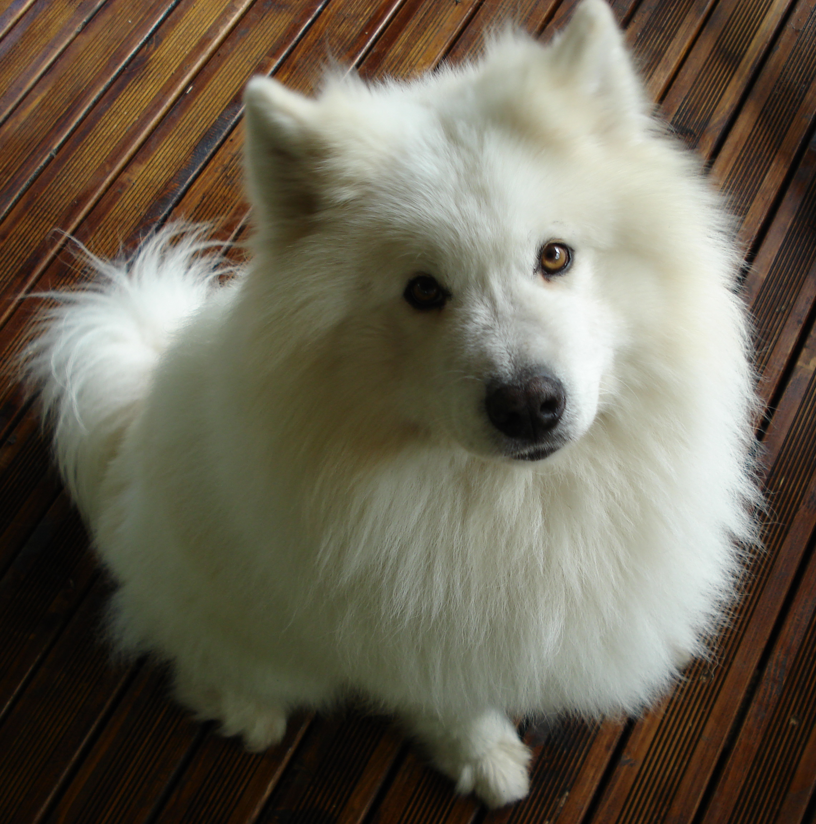
Here are the basics of MR imaging
Scanner =
big magnet + radio frequency transmitter
MAGNETIC FIELD
Hidrogen protons
When you put something inside a magnetic field, its H protons align (their spin) to the magnetic field.

Slide 10
Here are the basics of MR imaging
Scanner =
big magnet + radio frequency transmitter
MAGNETIC FIELD
Hidrogen protons
An RF pulse can tilt the orientation of the proton (‘s spin)

Slide 11
Here are the basics of MR imaging
Scanner =
big magnet + radio frequency transmitter
MAGNETIC FIELD
Coil =
RF receiver
Hidrogen protons
When the RF pulse stops, the protons reorient to the field emitting another RF signal.
The time taken is known as relaxation time.

Slide 12
Here are the basics of MR imaging
Scanner =
big magnet + radio frequency transmitter
MAGNETIC FIELD
Hidrogen protons
Different points in space have different relaxation times, and we can use those differences to reconstruct what is inside the scanner.

Slide 13

So… What are MR images?
1 mm
1 mm
If we zoom in, we can see that images are composed of pixels.
The size of each side of the pixel determines the image resolution
(1 x 1 mm, in this example).

Slide 14
So… What are MR images?
1 mm
1 mm
Each pixel contains one value (either 1 or 0, in this example).
The current color map assigns ”black” to 0 and “white” to 1.
But remember that the color map is arbitrary!
0
1

Slide 15
So… What are MR images?
1 mm
1 mm
1 mm
When we have a 3D image, we talk about voxels (1 x 1 x 1 mm, in this example).

Slide 16
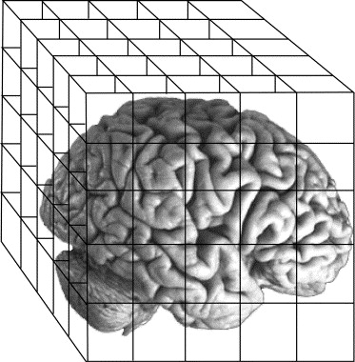
So… What are MR images?
Most common 3D file formats:
NifTi (.nii)
Compressed NifTi (nii.gz)

Slide 17
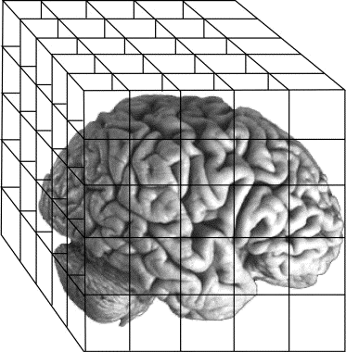
So… What are MR images?
Voxel size determines our image resolution: smaller = better.
Resolution is (partly) dependent on the strength of the magnetic field.
Common resolutions for different strengths:
1.5 Tesla ~ 3x3x3
3 Tesla ~ 2x2x2
7 Tesla ~ 0.8x0.8x.0.8
The earth's magnetic field, at the equator, is approximately
0.00005 T

Slide 18
Part I. Basics of MRI. Recap
- Scanner = magnet + RF transmitter
- MRI relies on the magnetic properties of the tissue.
- MR images are 3D “pictures” composed of voxels with one value per voxel.
- Most common 3D files: NifTi (.nii) and compressed NifTi (nii.gz).
- Spatial resolution depends on scanner strength.

Slide 19
Part II. Types of MR images

Slide 20
Types of MR images*
Anatomical images
Functional images
*For the purpose of this seminar only these two types will be covered since they are essential for standard fMRI analysis.

Slide 21
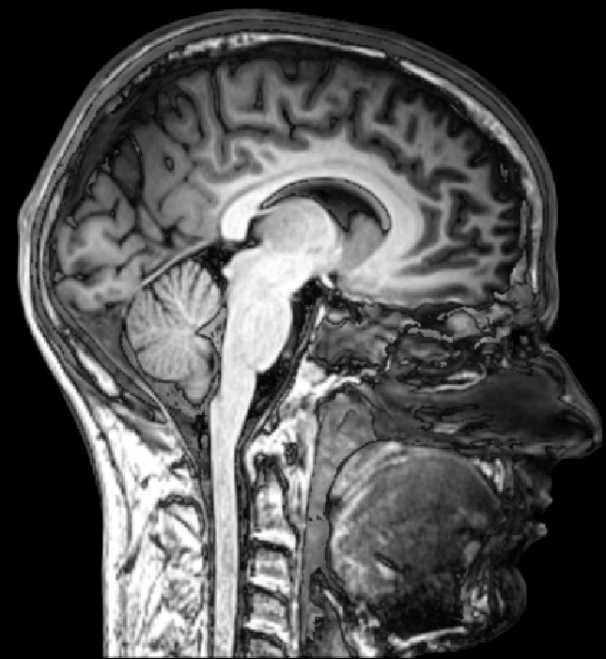
Types of MR images
Anatomical images
(T1w)
Functional images
Aim:
Structure
Feats:
Good spatial resolution.
Task free.
Slow acquisition
(~5 min full brain)
Differences in signal strength caused by different tissue types.

Slide 22
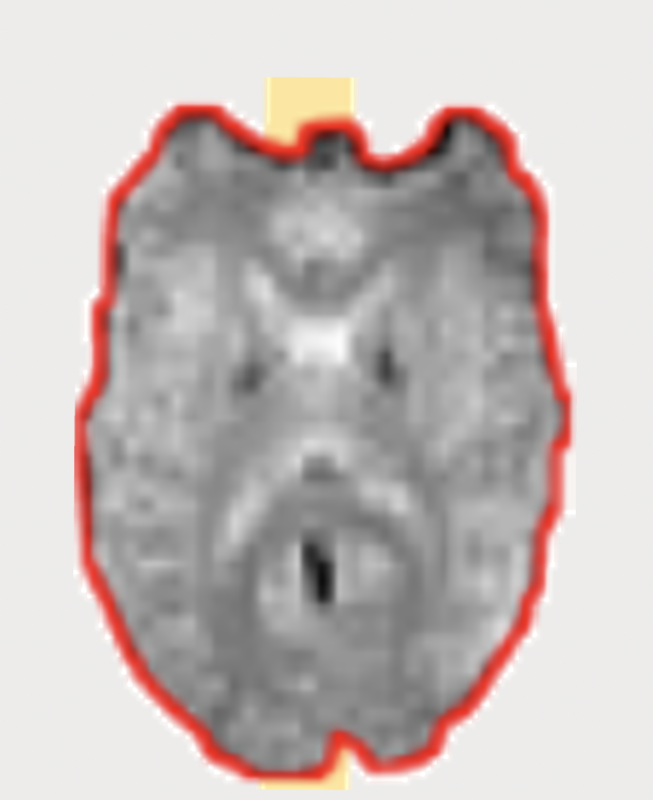
Types of MR images
Functional images
(T2*)
Anatomical images
Aim:
Activity
Feats:
“Good” time resolution.
Measures blood flow.
Task sensitive.
Fast acquisition
(~2s full brain)
Differences in signal strength caused by distortions in the magnetic field.

Slide 23
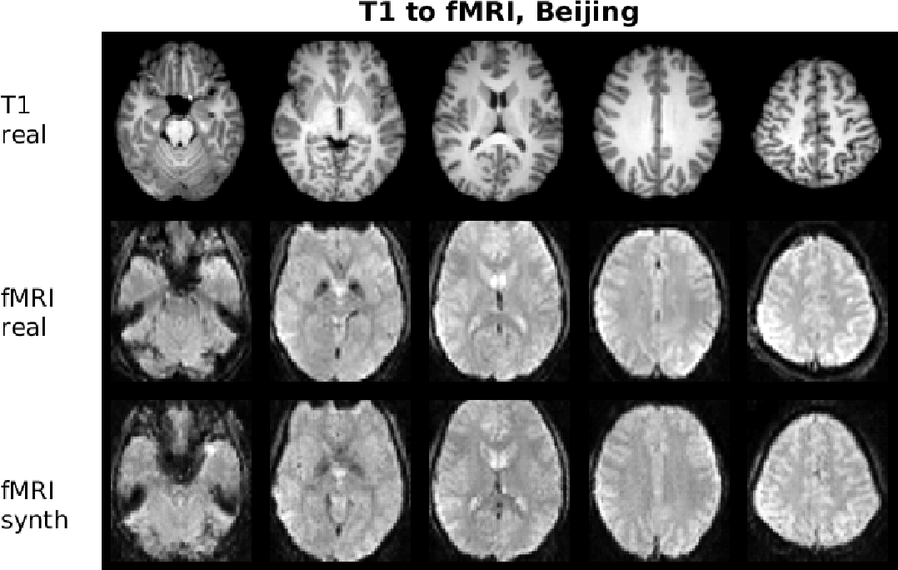
Types of MR images
Anatomical images
Functional images
How to distinguish them?
Inverse contrast!

Slide 24
Types of MR images
Anatomical images
Functional images
How to distinguish them?
Inverse contrast!
T1w:
Grey matter – dark
White matter - bright
T2:
Grey matter – bright
White matter - dark

Slide 25
Types of MR images
Anatomical images
Functional images
How to distinguish them?
Functional images have (usually) lower spatial resolution.
Gain in time resolution!
time

Slide 26
Types of MR images
Anatomical images
Functional images
How to distinguish them?
TR = time to sample the entire field (to collect one brain volume).
time
TR
TR
TR
TR
TR
TR
TR
TR
TR
TR
TR
TR

Slide 27
Types of MR images. Functional images
Functional runs. What are they?
Noise due to scanner drift accumulates over time so collecting images for too long will cause your images to look bad.
Solution: divide your task into shorter blocks, i.e., runs.
Aprox. run duration: ~10 minutes (adults) / ~6 minutes (children).
Max duration: 15 minutes (ideally shorter).
Run duration is often measured in volumes.
time
TR
TR
TR
TR
TR
TR
TR
TR
TR
TR
TR
TR

Slide 28
Part II. MR images types. Recap
Key ideas.
MR images can be roughly grouped into anatomical and functional images.
Anatomical images (usually one volume) have higher spatial resolution than functional images (usually several volumes).
TR = time to collect one brain volume.
Runs = blocks of recording time.

Slide 29
Part III. Image preprocessing

Slide 30
Preprocessing.
Why?
MR images as a reconstruction problem > This process is never perfect.
Distortions in MR images can be grouped in two types: temporal and spatial.

Slide 31
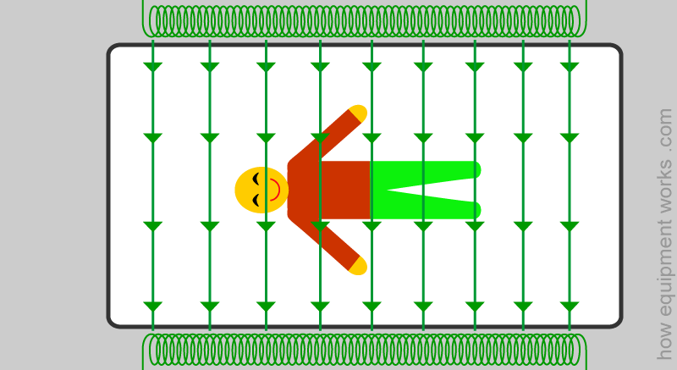
Preprocessing.
Why?
MR images as a reconstruction problem > This process is never perfect.
Distortions in MR images can be grouped in two types: temporal and spatial.
If collecting this entire volume takes 2s (TR=2s), it means that the top slice was acquired ~2 after the bottom one!
0s
Acquisition order
TRs

Slide 32
Preprocessing.
Why?
MR images as a reconstruction problem > This process is never perfect.
Distortions in MR images can be grouped in two types: temporal and spatial.
If collecting this entire volume takes 2s (TR=2s), it means that the bottom slice was acquired ~2 after the top one!
0s
Acquisition order
TRs
Time
0s
TRs

Slide 33
Preprocessing.
Why?
MR images as a reconstruction problem > This process is never perfect.
Distortions in MR images can be grouped in two types: temporal and spatial.
Slice time correction
0s
Acquisition order
TRs
Time
0s
TRs

Slide 34
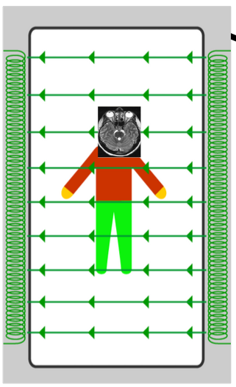
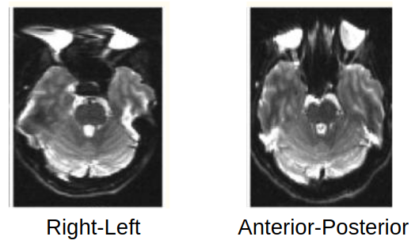
Preprocessing.
Why?
MR images as a reconstruction problem > This process is never perfect.
Distortions in MR images can be grouped in two types: temporal and spatial.
“Magnetic field inhomogeneities, caused by susceptibility differences at tissue/air and tissue/bone interfaces, result in significant geometric and intensity distortions. The challenge of reducing these field inhomogeneity effects arises from their spatial dependence. Data from different spatial locations are corrupted to different degrees, with the amount of corruption determined by the local magnetic field environment.” (Gholipour, et al., 2011).
Magnetic field inhomogeneities
Notes:
34

Slide 35
Preprocessing.
Why?
MR images as a reconstruction problem > This process is never perfect.
Distortions in MR images can be grouped in two types: temporal and spatial.
Magnetic field inhomogeneities
While some minor field inhomogeneity can be corrected by (automatic) shimming, much of it cannot…
Two main approaches to tackle the resulting distortions:
- Field map, i.e., acquiring a map of the magnetic field
- Blip up – blip down, i.e., acquiring an image in the inverted phase - encoding direction (Holland, Kuperman, & Dale, (2010).
Notes:
35

Slide 36
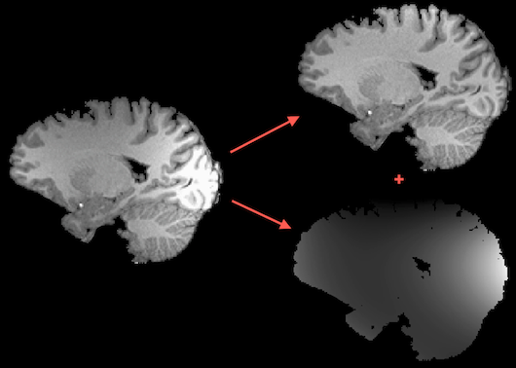
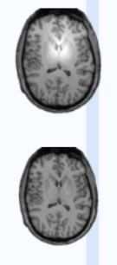
Preprocessing.
Why?
MR images as a reconstruction problem > This process is never perfect.
Distortions in MR images can be grouped in two types: temporal and spatial.
Intensity inhomogeneities
Notes:
36

Slide 37
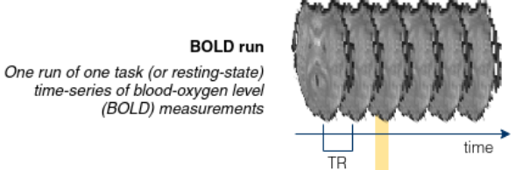
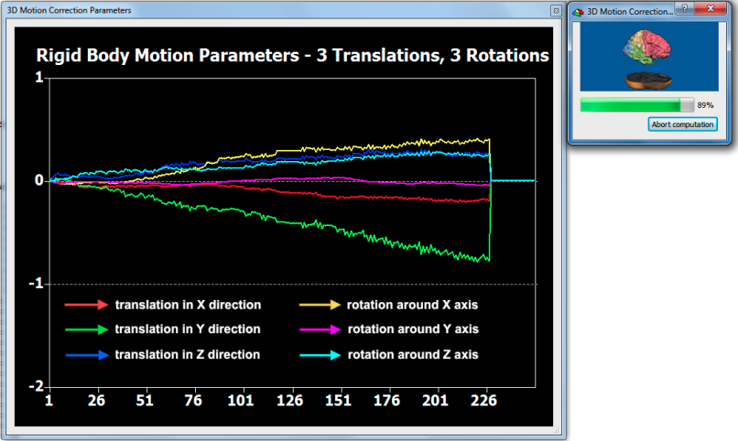
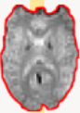
Preprocessing.
Why?
Functional MR images are recorded over time > Participants move!
Volumes need to be re-aligned!
Notes:
37

Slide 38
Preprocessing.
Why?
Anatomical and functional MR images are recorded at different time points and with different sequences > Volumes need to be registered to each other!
Notes:
38

Slide 39
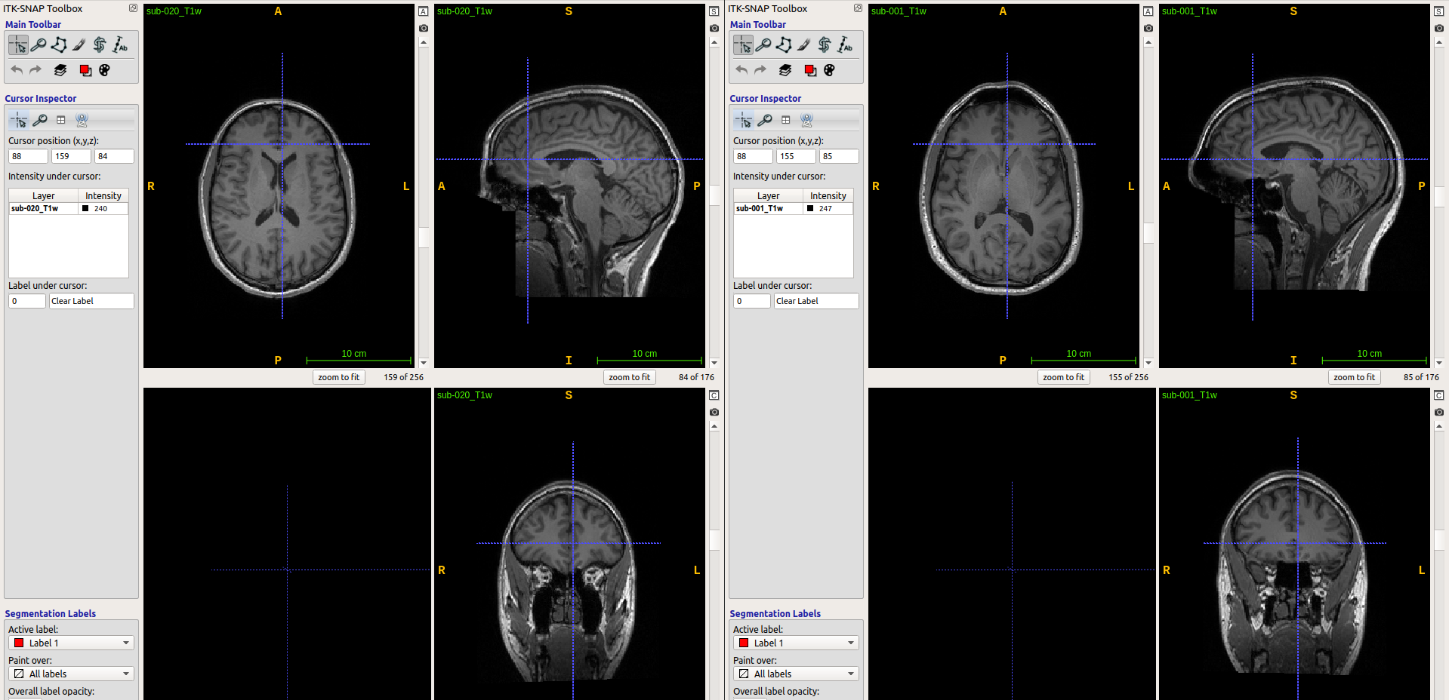
Preprocessing.
Why?
MR images are recorded for multiple individuals > Participants have different brain shapes!
We might want to have a common space for all of them.
Notes:
39

Slide 40
Preprocessing.
Why?
MR images are recorded for multiple individuals > Participants have different brain shapes!
Common spaces:
Native
MNI
Sample specific
Notes:
40

Slide 41
Part III. Image preprocessing. Recap
Key steps.
- Slice-time correction
- Magnetic field distortions
- Intensity inhomogeneities
- Motion correction
- Registration
- Normalization
Notes:
41

Slide 42
Part III. Image preprocessing. Recap
Key steps.
- Slice-time correction
- Magnetic field distortions
- Intensity inhomogeneities
- Motion correction
- Registration
- Normalization
How to do this?
- fMRIprep (https://fmriprep.org)
- SPM
- FSL
- BrainVoyager
- … and more
How to run fMRIPrep on your own:https://gitlab.com/ortizTud/neuroim-methods#010321-tutorial-on-fmriprep-ortiz
Notes:
42

Slide 43
Let’s get practical.
Software needed:
MATLAB 2018 or later (https://www.mathworks.com/)
SPM12 (https://www.fil.ion.ucl.ac.uk/spm/software/spm12/)
ITK-Snap 3.8.0 (http://www.itksnap.org/)
Data needed:
Know our repository:
https://github.com/ortiztud/fmri_analysis_intro
All the steps involved in preprocessing take a while to complete (up to several hours sometimes!)
We have already preprocessed all the images with fMRIPrep. You can find them under
~/<project_folder>/preproc_data/fmriprep/
Notes:
43

